Slide 1
Safety Case of The Libyan Centralized Radioactive Waste Storage Facility
Sustaining Cradle-to-Grave Control of Radioactive Sources (INT-9182) Meeting on the development, revision and implementation of the safety case and safety assessment Indonesia, 15 – 19 May 2017

Slide 2
Agenda
Introduction
SRS inventory
National laws regarding SRS
International treaties and conventions
RWM policy and strategy
Radioactive Waste Repository of TNRC
The National centralized storage facility for RW
SC/SA of the national centralized storage farcicality

Slide 3
Introduction
Libya is not a nuclear power country, however, this might be change in the near future.
Libya has a research reactor with nominal power of 10 MW since the beginning of 1980s.
SRS are used in Libya for: Medical applications in both diagnosis and treatment, Industrial applications mainly in the oil industry and for Research and education.

Slide 4
Introduction (Cont.)

Slide 5
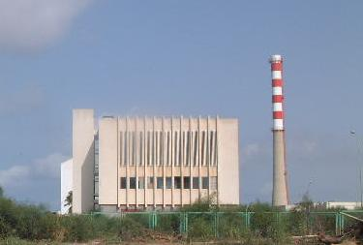
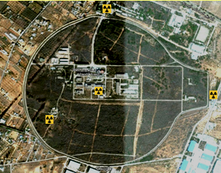
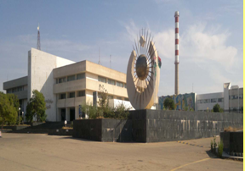
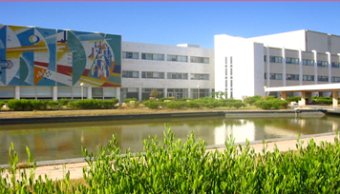

Slide 6
SRS inventory
From NRO official report (till the end of 2016):
- About 150 users are registered.
- The total number of sources used by these users are about 800.
- There are many other users not covered in this report, for instance, some involved in education (universities and institutes) and scientific research.
- There is about 100 DSRS located in the repository of TNRC.
- There is a plan to update the inventory to include all the possible available information about DSRS located in all user’s facilities around the country.
- An expert mission from IAEA to support Libya to improve its inventory and re-evaluate the existing RWM facilities at TNRC has been requested.

Slide 7
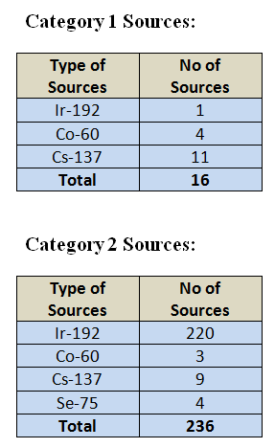
Cat. 1&2 SRS in the country

Slide 8
National Laws Regarding SRS (currently used)
Act#2 for the year 1982 aims to regulate the use of ionizing radiation and the prevention of its dangerous effects
Act#4, 2005, aims to regulate transportation of dangerous materials on the national roads.
Act#15, 2007, For Environmental protection and improvement.

Slide 9
The Libyan Nuclear Law (draft)
In order to achieve high levels of nuclear safety and radiation protection and the provision of suitable physical protection for nuclear materials and facilities, a Libyan nuclear law has been drafted in 2015. It complies with the highest international standards, and includes the relevant Libyan regulations. This draft sill waiting for the approval of the authority.

Slide 10
The main articles of the Libyan Nuclear Law
The Nuclear Regulatory Authority
The Regulatory System
Nuclear and Radiation Safety
Nuclear Security and Safeguards
Emergency Preparedness and Response
Licenses for Installations, Facilities and Decommissioning
Import, Export and Transport
Radioactive Waste and Spent Nuclear Fuel
Civil Liability and Penalties

Slide 11
International Treaties and Conventions
Non-Proliferation Treaty (NPT);
Convention on the Physical Protection of Nuclear Material;
Convention on Nuclear Safety;
Safeguards Agreements between the Agency and the States Required in Connection with the Treaty on the Non-Proliferation of Nuclear Weapons;
Convention on Early Notification of a Nuclear Accident;
Convention on Assistance in the Case of a Nuclear Accident or Radiological Emergency;
Basel Convention on the Control of Trans boundary Movements of Hazardous Wastes and in Cross-Border Disposal;
Treaty of London in the Prevention of Marine Pollution.
Libya is not party to the Joint Convention

Slide 12
RWM policy and strategy statements
Justification of facilities and activities
Emergency preparedness and response
Transparency and Public participation
Capacity building and education
Safety principles
Export/import policy
Waste minimization
Management of inventory
Liabilities for RWM
Resources
End-point for RWM

Slide 13
Specific issues regarding policy and strategy for DSRS
DSRS comprise a significant part of the radioactive waste currently stored at the users facilities; they are being used in areas of industry, scientific research. DSRS are stored at their user’s facilities without conditioning for further waste management stages.
The first priority is to reduce the number of DSRS needing long-term management. To facilitate this, the feasibility of repatriation or export to another country for recycling of Category 1 and 2 DSRS will be investigated. Furthermore, imports of new sources will be conditional upon their repatriation when they are no longer needed.

Slide 14
Specific issues regarding policy and strategy for DSRS (Cont.)
To improve the security of disused sealed radioactive sources and other radioactive wastes, a secure central store will be put into operation. This facility will facilitate decay storage for very short-lived sources, provide conditioning capability and allow safe and secure storage for all wastes until an authorized disposal facility becomes available.
The central storage capacity shall be sufficient to accommodate DSRS which have already been generated and which are expected to be accumulated in the next five decades to allow for the development of a suitable disposal option.

Slide 15
Radioactive Waste Repository of TNRC
The RW Repository is designed for disposal of solid and solidified liquid RW generated in TNRC, and is housed in a building sized 54m by 12m. The storage unit consists of a sunken waterproof concrete block covered with removable concrete slabs, and is equipped with a 5-ton crane. The repository contains 16 compartments with a storage capacity of 2640 m3.
The currently-used repository it was not designed to manage DSRS and SNF, furthermore, it should be used to host RW produced in TNRC.

Slide 16
The National centralized storage facility for RW
Libya has started a project to build a centralized storage facility for RW with the help of GRS Company in Germany as a bilateral agreement. The project started 2012 with a planned completion date within two years. Due to unforeseen national events, the project has been delayed.

Slide 17
Status of Safety Case / Safety Assessment for DSRS Stores
For each existing or planned store, is there a Safety Case / Safety Assessment (SC/SA)?
For the existing not, but for the planned centralized storage facility there is a draft.
How was the SC/SA reviewed?
Only by the operator.

Slide 18
Contents of the Safety Case
1. CONTEXT OF THE SAFETY CASE:
- Purpose of the SC
- Scope of the SC
- Demonstration of safety
- Graded approach:
* There is a vital need for the storage facility.
* The facility design will meet all safety requirements.
* The construction operations of the facility will be safe.
* The use and decommissioning of the facility will be safe.

Slide 19
Contents of the Safety Case (cont.)
2. Strategy for safety
The facility design will be simple and uncomplicated, using defense in depth safety and security principle; confirming the robustness of the facility over its lifetime and during any expected cases such as floods, earthquakes etc; enabling safe and easy visual inspection for all stored items, in the same time, the ability to safe and easy to retrieve them. Only high quality construction techniques and materials whose properties and sources are well known will be used in the facility.
The used management systems of the facility will guarantee that all safety and security work is done with high level of quality by adopting international safety standards. The facility personnel will be highly trained and qualified for there duties.

Slide 20
Contents of the Safety Case (cont.)
3. Description of the facility and the waste:
- Site conditions.
- System description.
- Waste.
4. Safety assessment
5. Management of uncertainties
- Any change in the neighboring population and activities.
- Any mistakes regarding the characterization of radioactive waste inventory.
- Any major changes in the use of radioactive waste materials in the country.

Slide 21
Contents of the Safety Case (cont.)
6. Iteration and design optimization
- The national inventory of RW.
- International strands of pre-disposal management of RW.
- High quality construction materials.
During the coming stages of the storage facility project, design improvements can be made depending on professional judgment.
7. Identification of safety measures
8. Integration of safety arguments

Slide 22
Safety Assessment
1. Radiological impact assessment
The potential radiological impact of the storage facility is addressed with the view of demonstrating that it will meet all safety requirements.
2. Development and justification of scenarios
- Internal Hazards:
* Movement hazard
* Receipt hazard
* Interim storage hazard

Slide 23
Safety Assessment (Cont.)
- External Hazards:
* Human induced events: aircraft crash, service failures, fire, theft, sabotage, terrorism.
* Natural events: earthquakes, extreme meteorological conditions, floods.

Slide 24
Safety Assessment (Cont.)
3. Engineering analysis
4. Passive safety
5. Defense in depth
6. Waste Management Operations
7. Non-radiological environmental impact

Slide 25
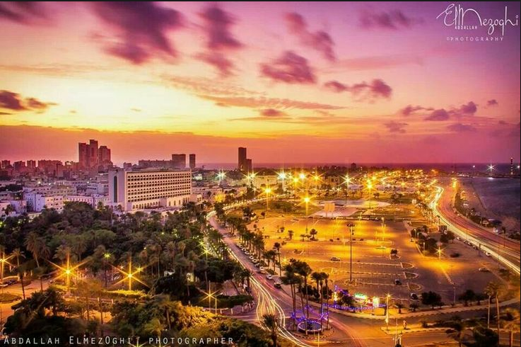
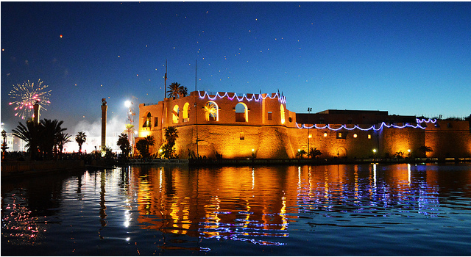
Thank you, any questions?

